Slide 1

Capstone Project
Predicting OF iMDB RATINGS Using supervised machine learning
HALAK DESAI
APRIL 2021

Slide 2

Why This Project?
I have always been curious to know `'WHY'` a decision was made and `'WHAT'` information supported it.
I like watching movies as most people do. I get recommendations on my subscription service all the time.
I observed that whenever I get a recommendation, I would immediately search for its ratings meaning how other people have liked the movie.
This got me thinking about what drives these ratings and why people like certain movie more than others and to take it a step further, What if I can Predict a Rating!
If I can predict a rating, then model could be helpful to investors, casting crew, producer, writers, etc. when creating a movie!

Slide 3

Feature Engineering
Considered Movies from year 2010-2020
Popular Actor (acted in more than 15 movies – top 15 by weighted average rating)
Popular Director (directed more than 5 movies – top 15 by weighted average rating)
Duration divided into 3 buckets (0 to 60 mins, more than 60 mins and less than 90 mins, and more than 90 mins)
Popular Genre (more than 4500 movies in a genre– top 4)

Slide 4
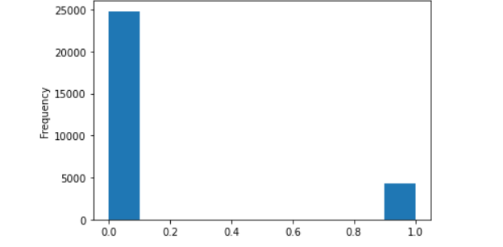
Target Value and Class Imbalance Problem
Class 0
Ratings Less than 7 = 85%
Class 1
Ratings Equal to or More than 7 = 15%
Class 0 and 1

Slide 5
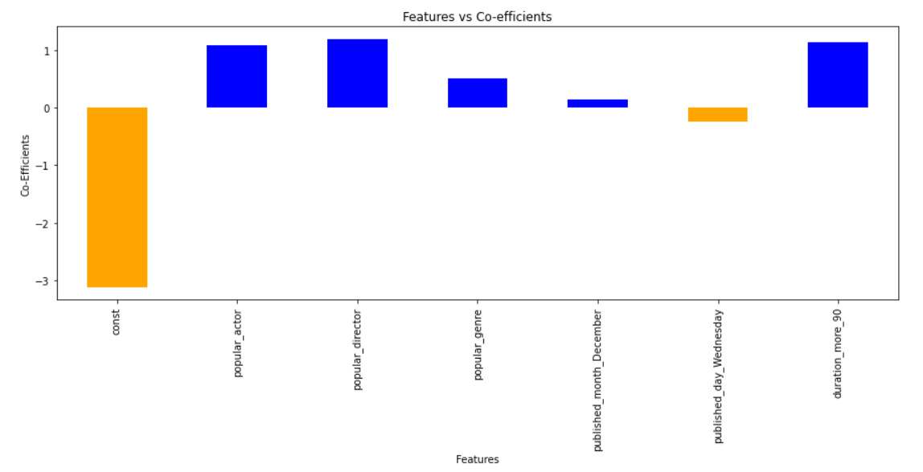

Statistical Analysis With Logistic regression
Casting a Popular Actor, Popular Director or making a movie in Popular Genre are going to increase odds for getting a rating of more than 7.
Releasing movie in month of December and keeping the duration of movie more than 90 mins are also going to increase odds for getting a rating more than 7.
Releasing a movie on Wednesday, is going to decrease our odds of getting a rating more than 7.

Slide 6

Model Results
Features | Imbalance Train Set | Imbalance Test Set | Oversampled – Train Set | Imbalance Test Set | Undersampled – Train Set | Imbalance Test Set
Score | 85% | 86% | 61% | 46% | 61% | 46%
Best Model | Decision Tree |  | Logistic Regression |  | Logistic Regression
Precision – Class 0 | Rating Less Than 7 |  | Rating Less Than 7 – |  | Rating Less Than 7 –
Recall- Class 0 | Rating Less Than 7 – |  | Rating Less Than 7 – |  | Rating Less Than 7 –
Precision – Class 1 | Rating More Than 7 – |  | Rating More Than 7 – |  | Rating More Than 7 –
Recall – Class 1 | Rating More Than 7 – |  | Rating More Than 7 – |  | Rating More Than 7 –
Decision Tree, Logistics Regression and SVM Used in Pipeline and GridSearchCV

Slide 7

Next Steps… Optimize model to improve precision score to make my model more reliable. - Try Ensemble Models - Find dataset for Revenue and budget for movies - Find if rating or budget affects revenue and or Model
CONTACT INFORMATION:
Email: halakmajmudar@gmail.com
LinkedIn: linkedin.com/in/HalakDesai
Github: HD208

